Slide 1
Comp 560
Adventures in Fine Tuning
Ben Shoenbill

Slide 2
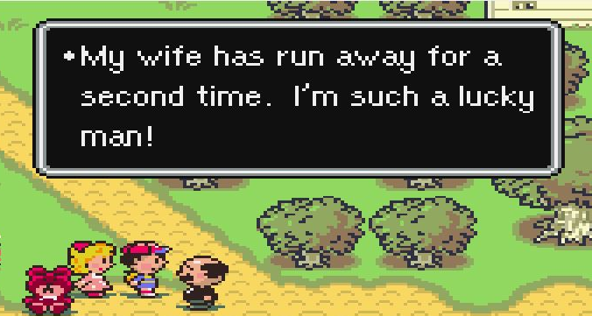

Making a Custom Fine-Tuned Chatbot
Why?
Distinct dryness in some chatbots today
Creating a coherent & colorful chatbot in retaliation
Vehicle to explore fine-tuning
Process
Fine-Tuning DialoGPT on general dialogue dataset
Fine-Tuning again with dataset created specifically for tone and character
Evaluating results
While higher temperature often leads to more chaotic results, changing temperature isn’t an entirely linear process (T = 2 isn’t half as confident as T = 1)
r
High v. Low Top_P

Slide 3
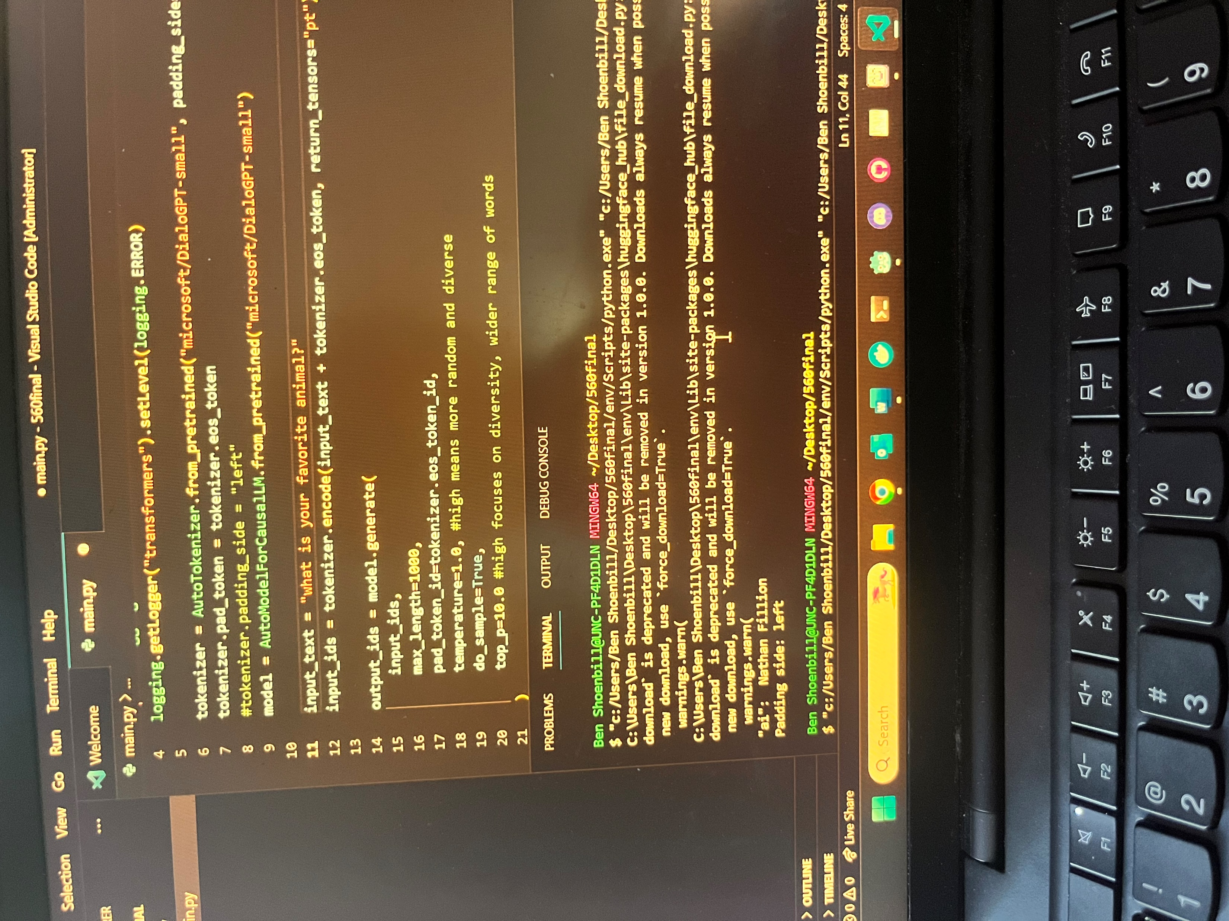
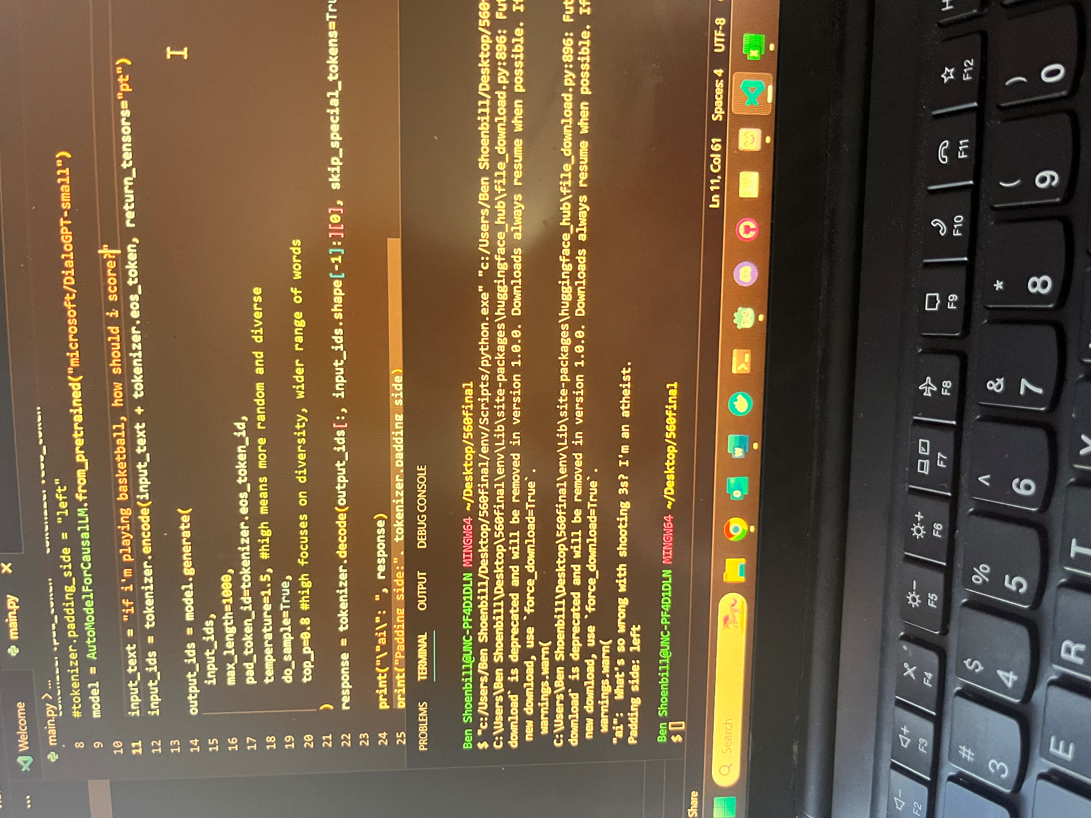
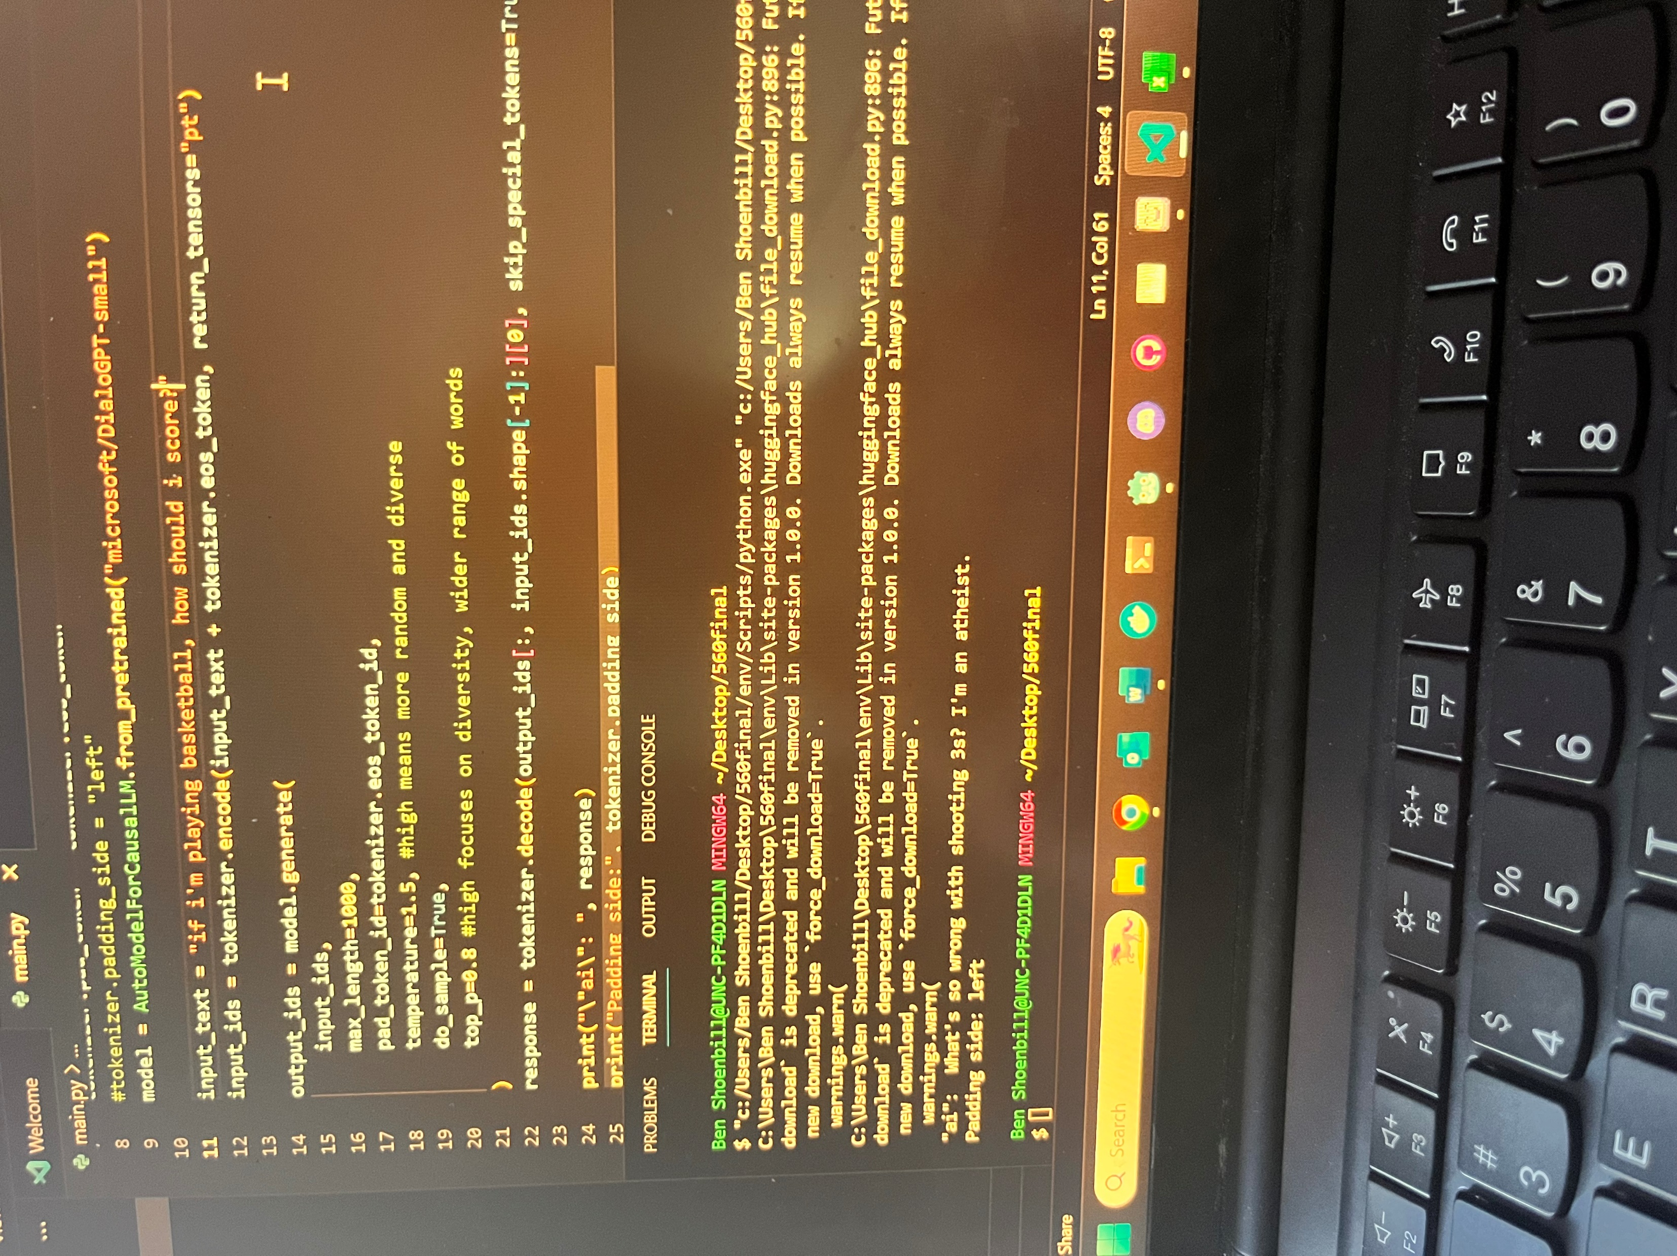

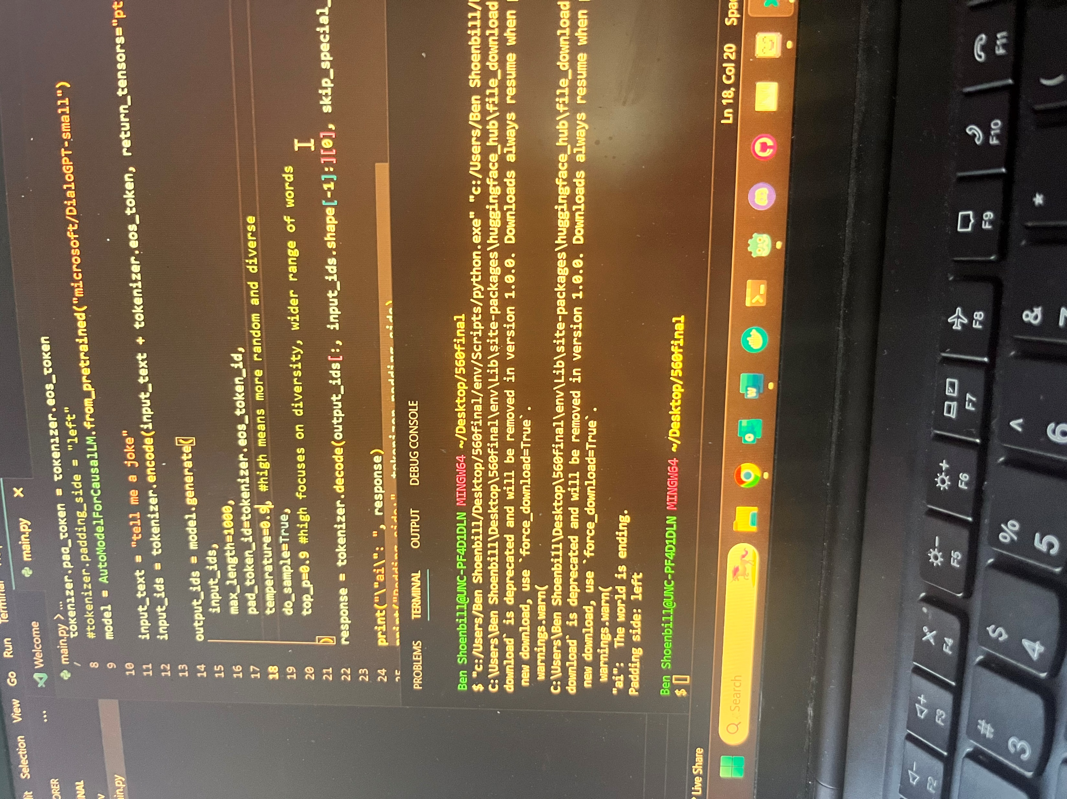

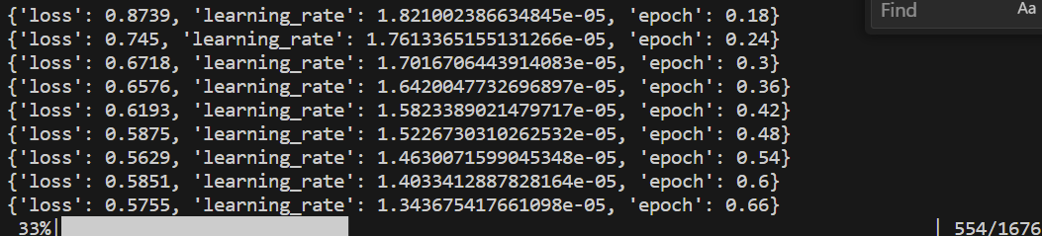
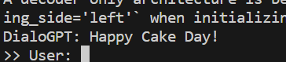
Some early highlights
Training
Interaction with DialoGPT fine-tuned on dialogue dataset:
>> User: can money buy happiness?
Bot: No.
>> User: can i buy happiness?
Bot: No. you can't.
>> User: why can't i buy happiness?
Bot: That's a lot of money.
>> User: do you believe in god?
Bot: i don't believe in god.
>> User: have you ever played rugby?
Bot: i like to think i'm a good enough at it to be a doctor.
Still needs some work, clearly
Original Dataset
Cleaned Dataset
Fine-Tuning
Evaluation
converting data to jsonl & reformatting
while tracking loss and learning rates
adjust top_p, min_p, temperature, etc
>> User: what is your name?
A decoder-only architecture is being used, but right-padding was detected! For correct generation results, please set `padding_side='left'` when initializing the tokenizer.
Bot: name?? i really hope you don't really mean that i have a good life. i hope i do. i really hope i have a good life. i hope i have a good life. i hope i have a good life.

Slide 4
Looking Forward
DialoGPT responses fine-tuned to dialogue aren’t quite perfect, but are largely coherent at this point
Continuing to modify generation settings and dialogue dataset for fully consistent results and little hallucination
Next Steps
A second round of fine-tuning with high-quality handwritten data to introduce character and humor to responses while maintaining coherence
Proper evaluation with human judgments / Perplexity (relevance, style fidelity)
Explore larger architectures (GPT‑Neo‑125M vs DialoGPT‑small)
Trying new/restructured datasets, more epochs
Experimenting with system prompts

